Slide 1
DS Group 7

Slide 2
Overview
Intro to Strava
Project aim
Design plan
Implementation update
Further steps

Slide 3
Intro to Strava
Activity tracker
Segments
Leaderboards
42 million users worldwide

Slide 4
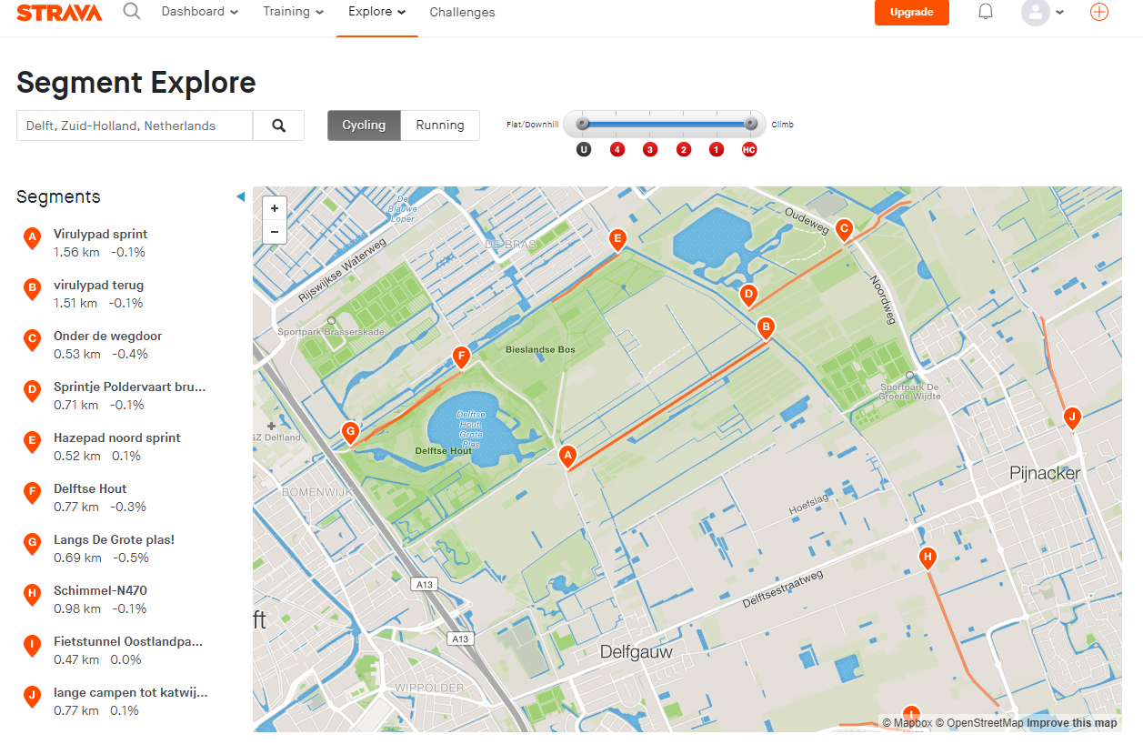

Slide 5
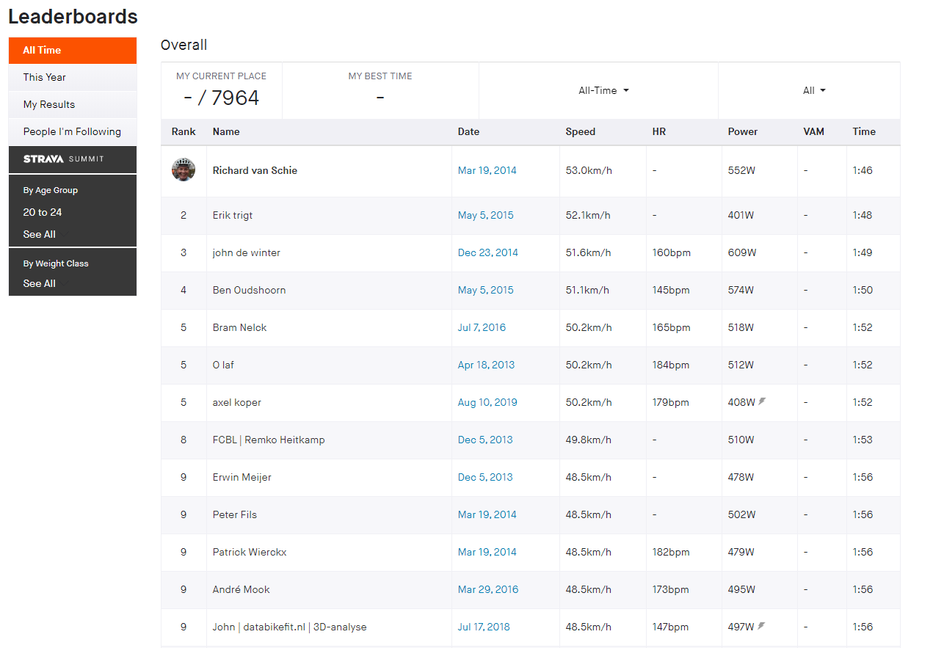

Slide 6
Project Aim
Find correlation between weather and places where Strava users cycle

Slide 7
Constraints

Slide 8
Design plan
Controller
Strava Module
Weather Module
Obtain data
Filter data
Weather score
Obtain data
Analysis
Heat maps
Base line

Slide 9
Implementation update
Weather data: ?
Strava: too many requests
Visualization module finished

Slide 10
Further steps

